Slide 1
From the Classroom to the Community (and back again)
Stories of Statistics, Significance, and Service
Joshua B. Wilkerson
Texas State University
www.GodandMath.com
2015 Joint Mathematics Meetings
San Antonio, TX

Slide 2
Big Idea
This presentation will outline the underlying motivation, basic design, and evaluation of service-learning based statistics projects in which students partner with non-profit organizations in their local community.
These projects synthesize the major concepts of experimental design, data analysis, and statistical inference in the real-world context of community service.
Through these projects students integrate their conceptual understanding of statistics with the practical functioning of their local community, ultimately gaining a deeper appreciation for the role statistics plays in the organization and evaluation of service societies.
Successful examples and practical resources for implementing and evaluating such projects can be accessed through GodandMath.com.

Slide 3
Motivation
Students are actually doing statistics.
  There is something about the physical practice of getting outside the classroom to collect and analyze data that implants an appreciation for the processes of statistics into students.
Students are actually doing statistics in an unfamiliar/uncomfortable (read: human) way.
  In service-learning there is interaction with actual human beings. The data on the paper now has a face and the analysis becomes a little messier and less clinical.
Students are actually doing statistics in an unfamiliar/uncomfortable (read: human) way and they (as well as the community) are experiencing firsthand the fruits of their labor.
Notes:
Students are actually doing statistics.
There is something about the physical practice of getting outside the classroom to collect and analyze data that implants an appreciation for the processes of statistics into students.
Students are actually doing statistics in an unfamiliar/uncomfortable (read: human) way.
In service-learning there is interaction with actual human beings. The data on the paper now has a face and the analysis becomes a little messier and less clinical. I find this tends to stretch students out of their comfort zone in a good way. It also encourages their focus to shift from individualistic outcomes (such as what grade they might receive) to more altruistic aims of education.
Students are actually doing statistics in an unfamiliar/uncomfortable (read: human) way and they (as well as the community) are experiencing firsthand the fruits of their labor.

Slide 4
Design
A non-profit service agency which requires survey research for program evaluation, grant applications, or client needs assessment is identified by the students.
Students will participate in a group which will provide the following services:
  Meeting with agency and developing a survey instrument
  Piloting and conducting survey*
  Compiling, organizing, and analyzing data
  Presenting final results to the agency
The teacher acts as a consulting facilitator outside of the direct chain of project command
*Adjustments may be necessary for organizations
that have already obtained data

Slide 5
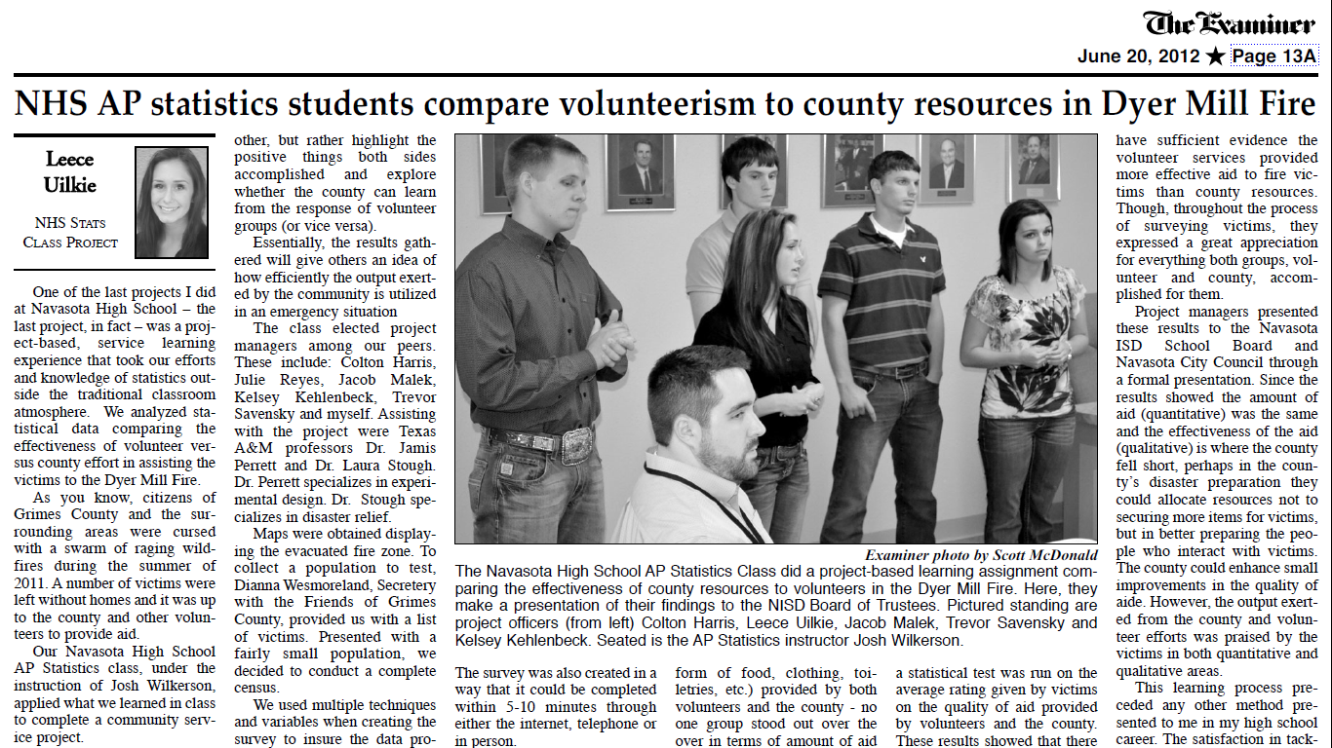
Examples
Examining volunteer retention in an inner city after school program
Analyzing adoption trends for a local no-kill animal shelter
Determining community satisfaction in regards to new developments by the city parks and recreation department
Evaluating the effectiveness of the city in providing aid to wildfire victims as compared to the aid provided by service organizations

Slide 6
Keys to Success
The Power of Choice
  Students have a vested interest in a personal topic
  “How can we apply the concepts learned in statistics to benefit our local community/service agencies?”
Meaningful Applications
  Real life scenario with real people
  The “Aha Moment” - Deep connections drawn from course material to project implementation
Improving Civic Mindset, Professionalism, and Presentation Skills
  Obligation is to the community/organization, not just a grade
  Comfort levels stretched through community interaction
Required Reflection Beyond Calculations
  Students chose the topic so they have to defend why it matters
  Importance of statistics cemented

Slide 7
Reflection
“Some people may think that this reflection process refers to a kind of ‘touchy-feely’ exercise that might be quite foreign to the mathematics classroom. I prefer to think of it as the processing of a rather complex set of experiences to assure that students share and solidify their insights and thus obtain maximum lasting benefits. This has actually been one of the most important contributions of the service-learning initiative.”
  Hadlock (2005)
“Service-learning in its most effective and well-developed sense is more than another name for ‘real-world learning’ and consists of more than applied work in the public/non-profit sector. It involves a multilayered reflection process that can substantially increase its educational value in a broad sense…. Service-learning reflection asks the learner to become more aware of what he/she brings to the learning process: values, assumptions, biases – many of which are unexamined and potentially problematic….To leave these aspects unexplored would be to miss a vital educational opportunity, for they invariably stir up thoughts and feelings highly deserving of reflection and discussion.”
  Zlotowski (2005)

Slide 8
Resources
www.GodandMath.com
Additional Resources:
  Mathematics Resources Page for the National Service-Learning Clearinghouse: www.servicelearning.org
  Issue of PRIMUS Dedicated to Successful Service Learning Resources (Volume 23, Issue 6, 2013): http://www.tandfonline.com/toc/upri20/23/6#.U4iSufldUmM
  Mathematics in Service to the Community: concepts and models for service learning in the mathematical sciences, Charles Robert Hadlock (MAA Notes Series)
  Service-Learning Session from JMM 2011: http://www.math-cs.gordon.edu/~kcrisman/SLTalks/

