Slide 1
Evaluating Effectiveness of
Grimes County Resources vs. Volunteers
in Providing Aid to Wildfire Victims
During the Summer of 2011
AP Statistics 2012
Navasota High School

Slide 2
Project Managers
Communications: Leece Uilkie
Population Acquisition: Colton Harris
Survey Development: Kelsey Kehlenbeck and Julie Reyes
Survey Administration: Jacob Malek
Data Analysis: Trevor Savensky

Slide 3
Outside Consultants
Dr. Jamis Perrett
  Assistant Professor
  Department of Statistics
  Texas A&M University
  Specialty: Experimental Design/AP Stat Curriculum
Dr. Laura Stough
  Associate Professor
  Department of Education Psychology
  Texas A&M University
  Specialty: Disaster Research

Slide 4
Introduction
The citizens of southeastern Grimes County were stricken by a series of wildfires during the summer of 2011.
One particular incident, the Dyer Mill Wildfire was isolated in Grimes County alone.

Slide 5
Mission
Our goal is to determine whether or not county officials were as effective at meeting the needs of wildfire victims in comparison to the several assisting volunteer organizations.
The results gathered should measure how efficiently the output exerted by the community is utilized in an emergency situation.

Slide 6
Process
Obtain Maps
Sample Selection

Slide 7
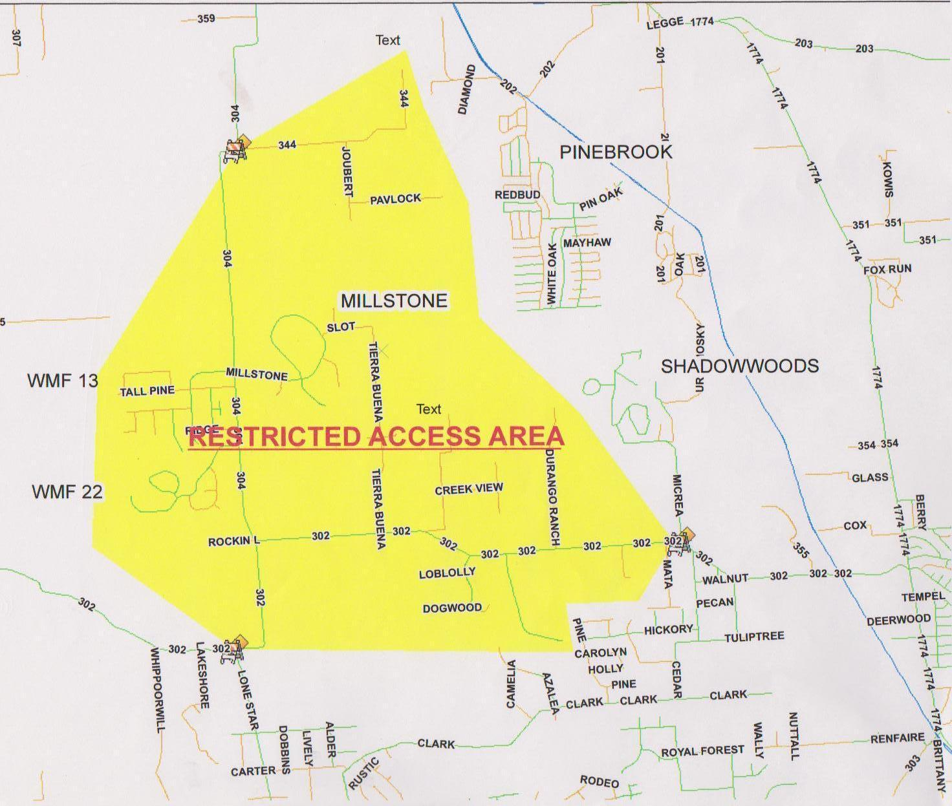

Slide 8
Obtaining A Sample
  The population of families that lost property was obtained from Dianna Wesmoreland.
  There were 53 members of this population
  Every member resides within the burn zone
  Every member reported some loss of property as a result of the fire
  People who were evacuated but sustained no physical damage to property were not considered

Slide 9
Process
Obtain Maps
Sample Selection
Create Survey
Pilot Survey

Slide 10
Developing the Survey
  Create a survey that reduces response bias by using neutral wording throughout the survey and keeping the same order of choices for each question.
  Create questions that will supply quantitative and qualitative results
  Handling language barriers
  Piloting sample survey
  Reflections and alterations to survey

Slide 11
Process
Obtain Maps
Sample Selection
Create Survey
Pilot Survey
Conduct Survey

Slide 12
Conducting the Survey
3 techniques were used to conduct the survey:
  Over the phone
  Through e-mail
  In person
As of now, we have received responses from 15 of the 53 households.

Slide 13
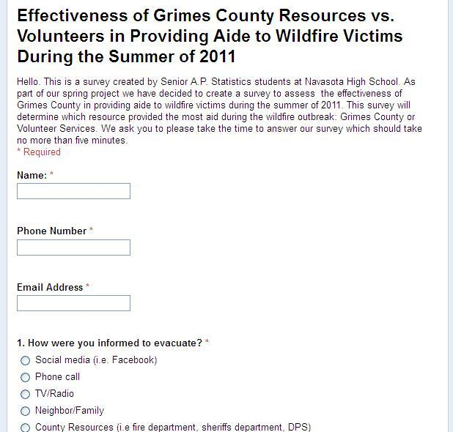

Slide 14
Process
Obtain Maps
Sample Selection
Create Survey
Pilot Survey
Conduct Survey
Analyze Data
Draw Conclusion

Slide 15
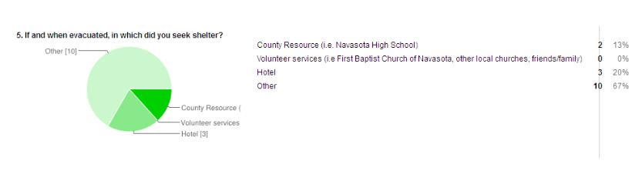
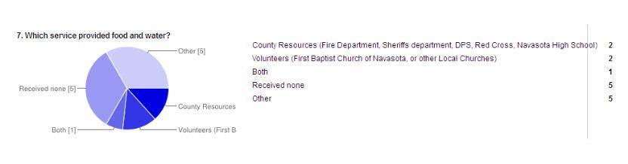
Survey Results

Slide 16
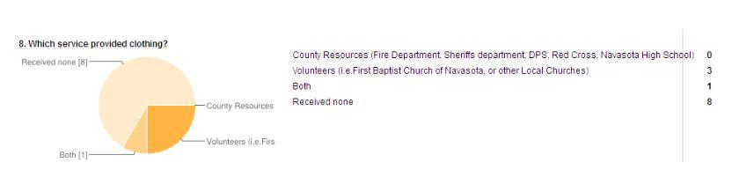
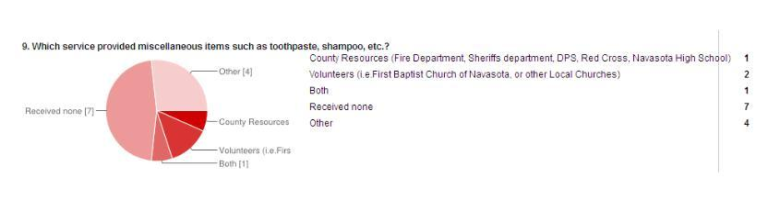
Survey Results

Slide 17
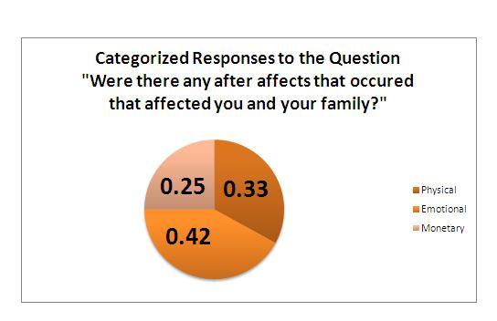
Survey Results

Slide 18
Sample Responses
"Lost everything including pictures, feels like past erased."
"Both of my children had nightmares for weeks, and instant panic attacks anytime they saw smoke in the air."

Slide 19
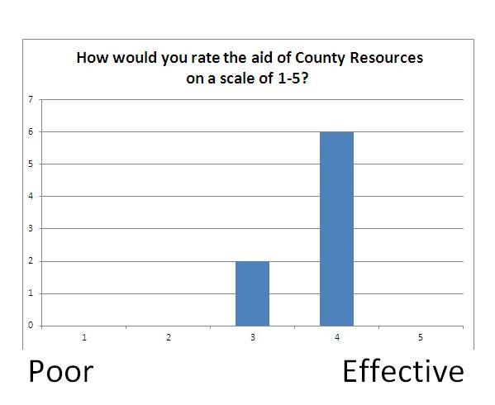
Survey Results

Slide 20
Sample Response to County Aid
"The only county resources I received was from the hard work of the fire departments."

Slide 21
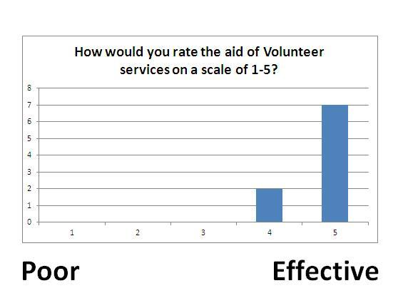
Survey Results

Slide 22
Sample Response to Volunteer Aid
"Wonderful helpers. Would give them a 10+. Came to help right away."

Slide 23
Testing Our Hypothesis
At first glance it appears that the average effectiveness of volunteer aid is greater than county resources (4.7>3.75). However, this could be due to sampling variability. To decide, we will conduct a 2- Sample T-Test (Comparison of means) with a significance level of .05.

Slide 24
Testing Our Hypothesis
Null Hypothesis:
Average Volunteer Effectiveness =
Average County Effectiveness
Alternative Hypothesis:
Average Volunteer Effectiveness >
Average County Effectiveness

Slide 25
Testing Our Hypothesis
Conditions:
a. Random Sample- Census
b. Independent Samples- Checked
c. Population approximately normal- Assumed
Since our sample is not completely random, we will proceed with caution.

Slide 26
Testing Our Hypothesis
Since our p-value .0003 is less than our significance level, we reject the null hypothesis and can conclude that the average volunteer effectiveness is greater than the average county effectiveness.
This conclusion was made with the knowledge that not all conditions checked.

Slide 27
Conclusion
Based on the data that we obtained from our surveys, we have sufficient evidence to conclude that the volunteer services provided more effective aid to fire victims than county resources.

Slide 28
Future Plans
Continue follow-up for non-responders
Refinement of data analysis
Presentation to City Council
Publication in local paper and possibly academic journal

