Slide 1
Beyond Practicality
George Berkeley and
the Need for Philosophical
Integration in Mathematics
Joshua B. Wilkerson
Texas A&M University
www.GodandMath.com
2012 Joint Mathematics Meetings
Boston, MA
Notes:
Greetings
As a mathematics educator, what is the number one question that you receive from students? (Slide Change)

Slide 2
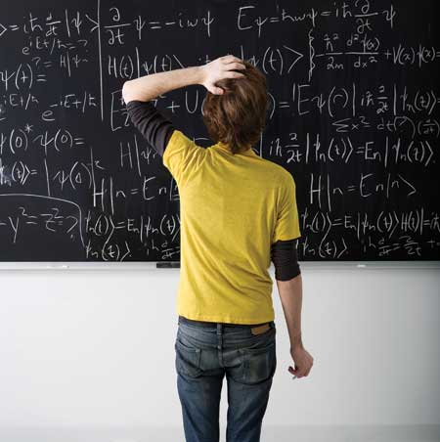
The Number One Question
Why should I value this?
When am I ever going to use this?
Notes:
Solicit responses
When am I ever going to use this? (transition)
As a mathematics educator, what are the responses you give to this question?
Solicit responses
Later in life
In a future class
Using it already (you just don’t realize it)
Appropriate answers to “when” questions but in my experience, not satisfactory to students
Students don’t want a date, they are really asking a different question (transition)
Why should I value this? (transition)
Expect a response based on practicality – how math will solve their problems and help them get ahead in life
Why is practicality such a virtue? Should it be? What other options do we have?(slide change)

Slide 3
Why Should I Value This?
Claim: Valuing mathematical inquiry for its own sake in the general pursuit of truth is a better mindset (or worldview) in which to approach the practice of mathematics rather than exalting its practicality.
Support: This mindset actually leads to more practical applications of mathematical endeavors than would otherwise be discovered.
Historical Evidence: The life and philosophy of George Berkeley
Notes:
(transition) Read claim
Why?
Numerous reasons, but if we are trying to fight against an ingrained mindset that values practicality, perhaps the best reason to begin with is that valuing mathematical study for its own sake leads to MORE practical applications than would otherwise be discovered (transition)
Lots of historical evidence – this paper will focus on George Berkeley and his objections against the calculus (transition)
Calculus is the culmination of high school study and a basic requirement of the majority of college students – and typically the highest math taken by none science, engineering majors
It seems then a fitting place to try and change student perceptions of mathematics (slide change)

Slide 4
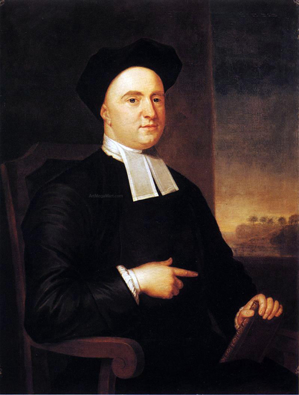
Overview
Berkeley’s Objection
Berkeley’s Motivation
Berkeley’s Impact
Berkeley’s Faith
George Berkeley Painting by John Smibert
Notes:
Berkeley’s objection
His critiques of the calculus as developed by Newton and Leibniz
His general dispute with the pervading mathematical philosophy of his day
Berkeley’s motivation
His philosophical convictions on mathematics fit into his broader philosophical pursuits
His views of math were rooted in his philosophical convictions
Berkeley’s impact
Examine the historical implications of his work
The refinement of the calculus and development of non-standard analysis
These developments are directly tied to Berkeley and might not have been pursued if the calculus was accepted on its utility alone
Berkeley’s faith is the ultimate foundation of both his philosophical and mathematical pursuits
will be discussed as an addendum if enough time (slide change)

Slide 5
Berkeley’s Objection
Berkeley’s Motivation
Berkeley’s Impact
Conclusions
Addendum: Berkeley’s Faith
Notes:
Beginning with Berkeley’s objection (slide change)

Slide 6
Berkeley’s Objection
Abstractionism
The Analyst
  The Calculus of Newton and Leibniz
  Infinitesimals (fluxions) – quantities so incredibly small that they are said to be between nothing and something
  “What are these fluxions?...They are neither finite quantities, nor quantities infinitely small, nor yet nothing. May we not call them ghosts of departed quantities?”
Notes:
The object of Berkeley’s attack was a philosophy of mathematics that characterized the discipline as a science of abstractions
Read: mathematical objects are the products of human thought
Read: the mind can “pare away” irrelevant features of perceived objects and thereby produce something appropriate for mathematical study
Example: Euclid’s definition of a line as “length without breadth” would be understood as an abstraction in which the mind mentally separates length from breadth, thereby forming an abstract object appropriate for the science of geometry
These attacks make sense in the context of his broader philosophical perspective, which we will explore shortly
The Analyst as Berkeley’s seminal work
Read notes on Analyst (slide change)

Slide 7
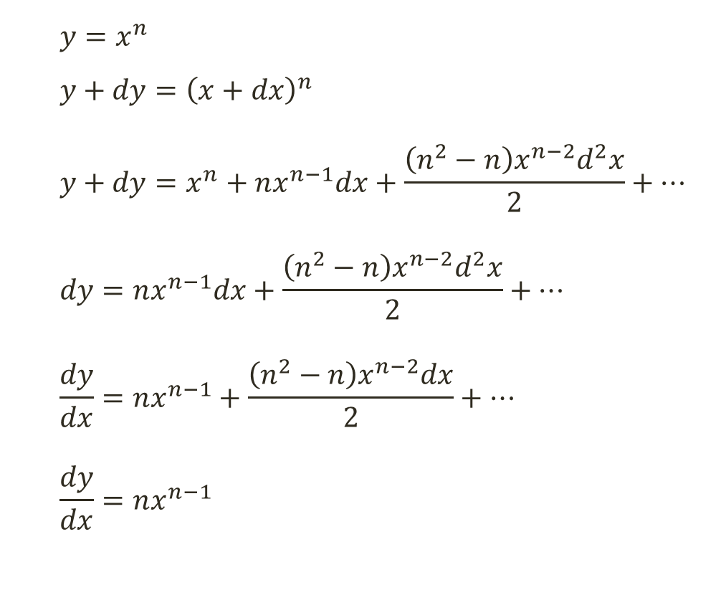
Berkeley’s Objection
(1)
(2)
(3)
(4)
(5)
(6)
  $$y=x^{n}$$
  $$y+dy={\left(x+dx\right)}^{n}$$
  $$y+dy=x^{n}+nx^{n−1}dx+\frac{\left(n^{2}−n\right)x^{n−2}d^{2}x}{2}+…$$
  $$dy=nx^{n−1}dx+\frac{\left(n^{2}−n\right)x^{n−2}d^{2}x}{2}+…$$
  $$\frac{dy}{dx}=nx^{n−1}+\frac{\left(n^{2}−n\right)x^{n−2}dx}{2}+…$$
  $$\frac{dy}{dx}=nx^{n−1}$$
Notes:
Talk briefly through the derivation of a derivative
Take the curve x^n
Add an “infinitesimal amount” – though this is given in a modern notation
Expand by binomial theorem
(3)-(1)=(4)
Divide by infinitesimal dx
Ignore the terms with dx – infinitesimally small
Get definition of derivative
Emphasize problem of something and nothing in 5 and 6 (slide change)

Slide 8
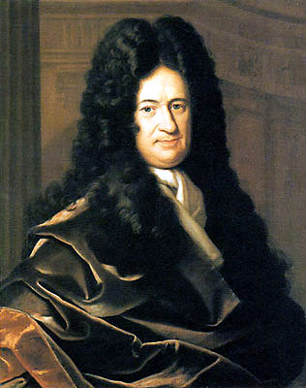
Berkeley’s Objection
[You may] think that such things are utterly impossible; it will be sufficient simply to make use of them as a tool that has advantages for the purpose of calculation.
- Gottfried Wilhelm von Leibniz
Notes:
Leibniz quote gives what was the majority opinion of the calculus foundations
Example of what Berkeley was objecting against
Example of how students think today – they don’t have to fully or deeply understand what they are doing, just do it and use it
Not sufficient on Berkeley’s view and shouldn’t be sufficient on ours
I also use this quote to clarify Berkeley’s objection and make clear what he is NOT objecting against (slide change)

Slide 9
Berkeley’s Non-Objections
The practicality of mathematics
The utility of the Calculus and the validity of the results it obtained
Accepted methods of mathematical inquiry, deduction, and rigor
Notes:
Not opposed to practicality, but it must be arrived at in a mathematically appropriate (rigorous) way
Berkeley agreed that the calculus was useful…but that in and of itself wasn’t enough
He thought it was so useful, he tried to make Newton’s inconsistent argument consistent
The argument of the compensation of errors
Derivative both simultaneously over and under estimates the curve
Its bad, but the important thing isn’t the outcome of the argument, but why Berkeley undertook it – to be rigorous in setting the foundations of a mathematical concept (slide change)

Slide 10
Berkeley’s Objection
Berkeley’s Motivation
Berkeley’s Impact
Conclusions
Addendum: Berkeley’s Faith
Notes:
Let us discuss Berkeley’s motivation behind his objections
That is – how his philosophical convictions drove his mathematical objections (slide change)

Slide 11
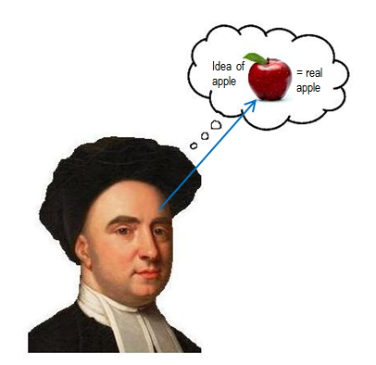
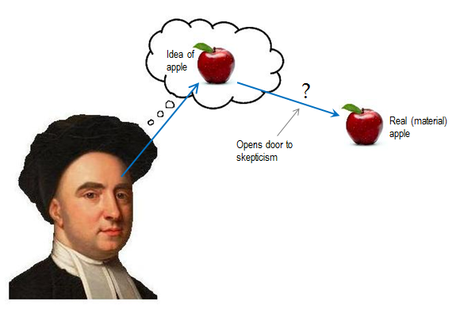
Berkeley’s Motivation
Immaterialism
  Objects exist in minds
  To exist is to be perceived
Images by Stephen Puryear
Notes:
To understand Berkeley’s philosophy in brief
To exist is to be perceived
The connection (or lack thereof) between our perception of reality and reality leaves the door open to skepticism (ex: how do you know you aren’t in the Matrix?)
Berkeley’s solution to the gap is to say “The idea IS the thing”
To exist is to be percieved
If it can’t be perceived… can see where this leads with infinitesimals (slide change)

Slide 12
Berkeley’s Motivation
Applied to the Calculus
Philosophical Commentaries (354)
    “Axiom. No reasoning about things whereof we have no idea. Therefore no reasoning about Infinitesimals.”
Robert J. Fogelin, Berkeley and the Principles of Human Knowledge (p. 136)
  “His attack on infinite divisibility found in mathematics….exhibits a strategy employed throughout Berkeley’s philosophical writings, that of showing us that we do not understand something we think we understand since the words we use refer to nothing intelligible.”
Notes:
To be something and nothing is unintelligible and therefore cannot exist
Cannot perceive an infinitesimal
(transition) read quote
You can see this view of infinitesimals is consistent with his general philosophy
(transition) Read quote
it his philosophy that is driving his mathematics (slide change)

Slide 13
Berkeley’s Objection
Berkeley’s Motivation
Berkeley’s Impact
Conclusions
Addendum: Berkeley’s Faith
Notes:
Let us now discuss the impact of Berkeley’s philosophical mathematics (slide change)

Slide 14
Berkeley’s Impact
Florian Cajori, A History of the Conceptions of Limits and Fluxions in Great Britain
George Berkeley’s publication of The Analyst has been considered the most spectacular event in the history of 18th century mathematics
At the very least it must be acknowledged as a turning point in the history of mathematical thought in Great Britain
Notes:
Berkeley’s impact can vary depending on who you read
Read 2nd point
Florian Cajori may overstate his case initially
(transition)
but his final statement here is accurate
We can follow the turning point through various mathematicians as the calculus gained a more stable foundation (slide change)

Slide 15
Berkeley’s Impact
On the development of the Calculus
  After the publication of The Analyst in 1734 there appeared within the next seven years some 30 pamphlets and articles which attempted to remedy the situation
  Maclaurin states in the preface of his Treatise of Fluxions in 1742 that he undertook the work to answer Berkeley’s attack – favored a limit approach to the problem, though not fully defined
  Cauchy followed MacLaurin with his Cours d’Analyse in 1821, providing a workable definition of limits and a means to make them the basis of a rigorous theory of calculus, though he still referenced infinitesimals
  A few years later, Weierstrass eliminated infinitesimals altogether by means of his (ε, δ) approach
Notes:
Talk through points as they appear on slide
(transition) – immediate response after The Analyst
(transition) – Maclaurin
(transition) – Cauchy
(transition) – Weirstrass
Mention there were others (like Lagrange), but this is a traceable path back to Berkeley (slide change)

Slide 16
Berkeley’s Impact
On the development of Non-Standard Analysis
  Abraham Robinson, 1966
  Robinson on Berkeley:
    “It is in fact not surprising that a philosopher in whose system perception plays the central role, should have been unwilling to accept infinitary entities.”
  Infinitesimals appeal naturally to our intuition and can be rigorously defined – the “inconceivable” can be conceived
Notes:
(transition) Abraham Robinson writes at length on the influence of Berkeley on his own work
(transition) He also wrote on Berkeley’s perspective, trying to understand his approach – states what we have covered here
(transition)
Goal was to take what Berkeley called inconceivable and design rules to make them conceivable
Not trying to get around infinitesimals like the limit definition
Trying to make infinitesimals rigorous
Nonstandard analysis is concerned only with the equivalence of two elements (a ≈ b) which does not require a = b, but only that a is infinitely close to b, i.e. that a – b is infinitesimal
Robinson now adds this definition of a hyperreal. A hyperreal is infinitesimal if it is smaller than all positive standard reals
Every finite hyperreal x has a unique standard part, denoted by std(x).
For those unfamiliar, it is much like every complex number has a real and complex part
Each finite hyperreal has a unique expression as standard real plus infinitesimal (slide change)

Slide 17
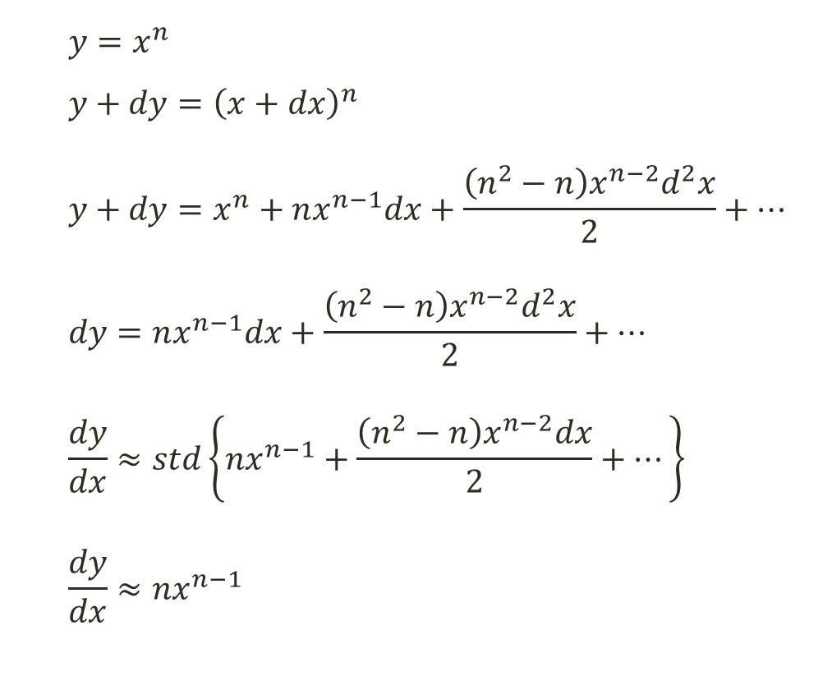
Berkeley’s Impact
(1)
(2)
(3)
(4)
(5*)
(6*)
  $$y=x^{n}$$
  $$y+dy={\left(x+dx\right)}^{n}$$
  $$y+dy=x^{n}+nx^{n−1}dx+\frac{\left(n^{2}−n\right)x^{n−2}d^{2}x}{2}+…$$
  $$dy=nx^{n−1}dx+\frac{\left(n^{2}−n\right)x^{n−2}d^{2}x}{2}+…$$
  $$\frac{dy}{dx}≈std\left\{nx^{n−1}+\frac{\left(n^{2}−n\right)x^{n−2}dx}{2}+…\right\}$$
  $$\frac{dy}{dx}≈nx^{n−1}$$
Notes:
Difference in 5 and 6
In nonstandard analysis there are actual infinities and actual infinitesimals. They are constants and not Cauchy-style variables.
It’s as if each standard real is surrounded by a fuzzy cloud of infinitely close hyperreals
Although this might seem cumbersome notationally, the more complex formalism of nonstandard analysis was but a small price to pay for the removal of inconsistency
Nonstandard analysts have since made advancements in numerous fields
perturbation theory, computer graphics, polynomial equations, fast-slow flows, geodesics, boundary value problems, boundary layer flow, stochastic differential equations, and spin systems in mathematical physics.
perhaps another (and promisingly fruitful) application of nonstandard analysis is in pedagogical practice.
anything that can be proved with calculus can also be proved by classical geometry. In no way does this imply that calculus is worthless. In the same way, the correct question is whether nonstandard analysis is a more powerful piece of machinery (slide change)

Slide 18
Berkeley’s Objection
Berkeley’s Motivation
Berkeley’s Impact
Conclusions
Addendum: Berkeley’s Faith
Notes:
Wrapping up (slide change)

Slide 19
Conclusions
George Berkeley’s philosophy of mathematics was deeply intertwined with his practice of mathematics
These philosophical convictions are what drove him to attack the methods of Newton in The Analyst, despite the concession that the calculus had utility
By not accepting the calculus on its practical applications alone, Berkeley set the stage for the refinement of the calculus and the development of more practical applications in non-standard analysis
The case of George Berkeley provides historical evidence of a philosophical approach to mathematics leading to greater mathematical applications
Notes:
Talk through conclusions
(transition) – philosophy intertwined with mathematics
(transition) – philosophy drove his unacceptance of Newton’s formulation of the calculus
(transition) – Berkeley’s objections led to the development of MORE practical applications
Refinement of the calculus
Development of non-standard analysis
(transition) – in summary, Berkeley gives us historical evidence for taking a philosophical approach to doing mathematics
And this approach led to more practical applications
Therefore those who exalt practicality, and follow the Leibniz quote, will ironically miss out on the practical implications of a mathematical endeavor
Thank you
If time (slide change)
If not, (slide change to end) then take questions

Slide 20
Berkeley’s Objection
Berkeley’s Motivation
Berkeley’s Impact
Conclusions
Addendum: Berkeley’s Faith
Notes:
Berkeley’s faith is the grounding of everything else he studied

Slide 21
Berkeley’s Faith
A worldview which integrates philosophy and mathematics is needed to best pursue mathematical applications
The immediate follow up question is: “how does one go about integrating philosophy and mathematics correctly?”
“All Berkeley’s endeavors were directed to the defense of what he saw as the most important truth – that we are in a constant and immediate relationship of dependence on God. Berkeley’s philosophy…was a provisional instrument in the service of his overriding apologetic aim.”
    Gerald Hanratty, Philosophers of the Enlightenment: Locke, Hume and Berkeley Revisited.
The Analyst: whether the objects, principles, and inferences of the modern analysis are more distinctly conceived, or more evidently deduced, than religious mysteries and points of faith
Notes:
Read point 1
(transition)
Read point 2 – how do we integrate?
If you think Berkeley is an example to be followed – to fully understand his perspective you must realize he was a deeply committed Christian
(transition)
His faith drove all of his endeavors
Can see this even in the subtitle of the Analyst
(transition)
His goal was to demonstrate the inconsistency of Newton, but uses the opportunity to make an informal apology for Christianity
How do we best integrate philosophy and math? On Berkeley’s view, through Christian convictions (slide change)

Slide 22
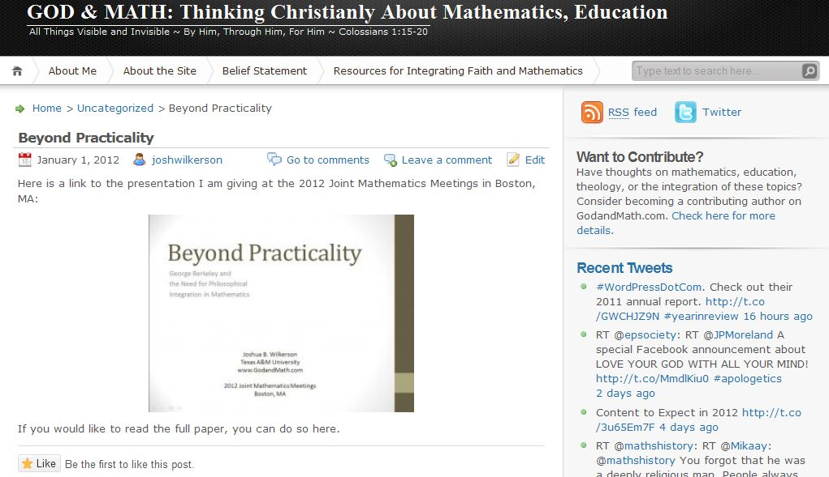
www.GodandMath.com
The complete paper and this presentation can be found here
Notes:
Plug site
Questions?

